Slide 1
Advanced Design and Analysis of Algorithms
1. Introduction

Slide 2
Introduction
Abu Ja'far Muhammad ibn Musa Al-Khwarizmi
[Born: about 780 in Baghdad (now in Iraq). Died: about 850]
The word “algorithm” is derived from the Latinization of his name, and the word "algebra" is derived from the Latinization of "al-jabr", part of the title of his most famous book, in which he introduced the fundamental algebraic methods and techniques for solving equations.

Slide 3
What is algorithm?
An algorithm is a step-by-step procedure for performing some task in a finite amount of time.
An algorithm is any well defined computational procedure that takes some values, or set of values as input and produces some values or set of values, as output.
An algorithm is thus a sequence of computational steps that transform the input into output.

Slide 4
Algorithm and programming
A good algorithm is essential for programming.
However unlike a program, algorithm is a mathematical entity.
The combination of both these things will be introduced in this course.
Algorithm is not depends on a specific programming language, machine or compiler.
Algorithm design is about mathematical theory behind the design of a good programs.
The pre requisite of this course is a programming, you should be able to write a program in any language i.e. C++, Python, MATLAB etc.

Slide 5
Why we study Algorithms?
The fact is that many of the courses in computer science deal with efficient algorithms and data structures.
A good understanding of algorithm design is a central element to a good understanding of computer science and computer programming.

Slide 6
What is Data Structure?
A data structure is a systematic way of organizing and accessing data. Some basic data structures follows.
Array
Stacks
Queues

Slide 7
Random Access Machines
A random access machine (RAM) is a simple model of computation. Its memory consists of an unbounded sequence of registers. Each of the registers may hold an integer value.
The control unit of a RAM holds a program, i.e. a numbered list of statements. The program counter determines which statement is to be executed next.

Slide 8
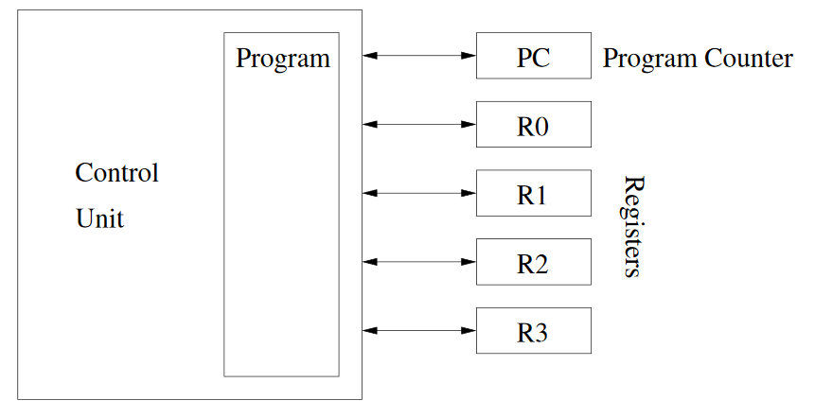
Rules for executing a RAM-program:
In each work cycle the RAM executes one statement of the program;
The program counter specifies the number of the statement that is to be executed

Slide 9
Program
Program: Program is an implementation of an algorithm in some programming language.
Data structure + Algorithm = Program

Slide 10
Design and Analysis of Algorithm
1. The “design” pertains to
The description of algorithm at an abstract level by means of a pseudo language.
Proof of correctness that is, the algorithm solves the given problem in all cases.
2. The “analysis” deals with performance evaluation (complexity analysis).

Slide 11
Problems, Solutions, and Tools
A computer does not solve problems; it's just a tool that we can use to implement our plan for solving the problem.
A computer program is a set of instructions for a computer. These instructions describe the steps that the computer must follow to implement a plan.
An algorithm is a plan for solving a problem.
A person must design an algorithm.
A person must translate an algorithm into a computer program

Slide 12
Algorithm Development Process
Our algorithm development process consists of five major steps.
Step 1: Obtain a description of the problem.
Step 2: Analyze the problem.
Step 3: Develop a high-level algorithm. Or Find an algorithm to solve it.
Step 4: Refine the algorithm by adding more detail.
Step 5: Review the algorithm.

Slide 13
What is efficient algorithm?
What is a good algorithm?
Efficient is something, which has small running time and takes (spaced used) less memory.
We would be spending more time on analyzing the running time of an algorithm.
We will also spend some time on analyzing the space.
Efficiency of an algorithm is a function of input size.

Slide 14
Measuring the Running Time:
How should we measure the running time of an algorithm?
Experimental Study
Write a program that implements the algorithm.
Run the program with data sets of varying size.

Slide 15
Limitations of Experimental Studies
It is necessary to implement and test the algorithm in order to determine its running time.
Experiments can be done only on a limited set of inputs, and may not be indicative of the running time on other inputs not included in the experiment.
In order to compare two algorithms, the same hardware and software environments should be used.

Slide 16
Time and space
To analyze an algorithm means:
Developing a formula for predicting how fast an algorithm is, based on the size of the input (time complexity) ,and /or
Developing a formula for predicting how much memory an algorithm requires, based on the size of the input (space complexity)
Usually time is our biggest concern
Most algorithms require a fixed amount of space

Slide 17
Time Complexity
Factors that should not affect time complexity analysis:
The programming language chosen to implement the algorithm.
The quality of the compiler.
The speed of the computer on which the algorithm is to be executed.

Slide 18
Standard analysis techniques
Analyzing loops
Analyzing nested loops
Analyzing sequence of statements
Analyzing conditional statements

Slide 19
What is Big O Notation?
Big O notation is used in computer science to describe the performance or complexity of an algorithm.
Big O specifically describes the worst-case scenario, and can be used to describe the execution time required or the space used by an algorithm.

Slide 20
Constant time statements
Simplest case: O(1) time statement
Assignment statement of simple data types int x=y;
Arithmetic operations y = 5*y+4-z;
Array referencing A[j] = 5;
Most conditional tests if(x<12)…

Slide 21
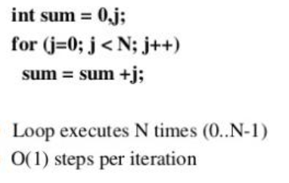
Analyzing loops
Any loop has two parts
How many iterations are performed
How many steps per iteration
Total time is
N*O(1) = O(N*1) = O(N)

Slide 22
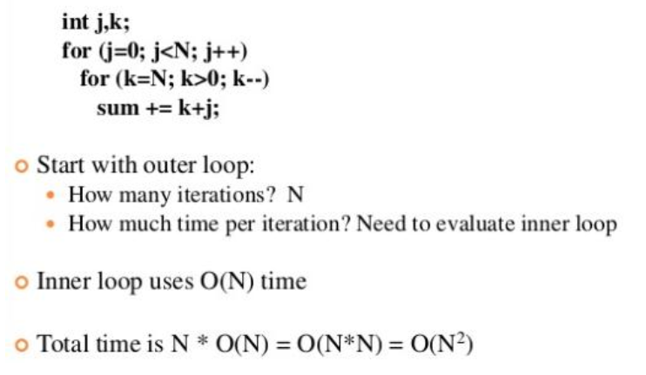
Analyzing nested loops
Treat just like a single loop and evaluate each level of nesting as needed

Slide 23
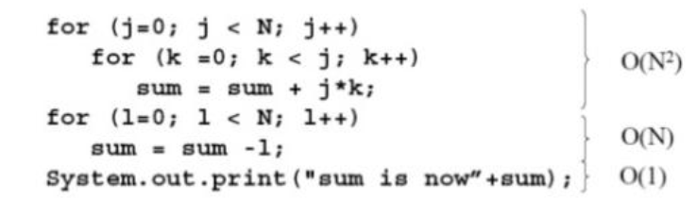
Sequence of statements
For a sequence of statements compute their complexity functions individually and sum them up.
Total cost is O(N²) + O(N) + O(1) = O(N²)

Slide 24
Conditional statements
What about conditional statement such as
If (condition)
Statement 1;
else
Statement 2;
where statement 1 runs in O(N) times and statement 2 runs in O(N²) time. We use the worst case complexity among all inputs of size N. what is the maximum running time?
The analysis for the example above is O(N²).

Slide 25
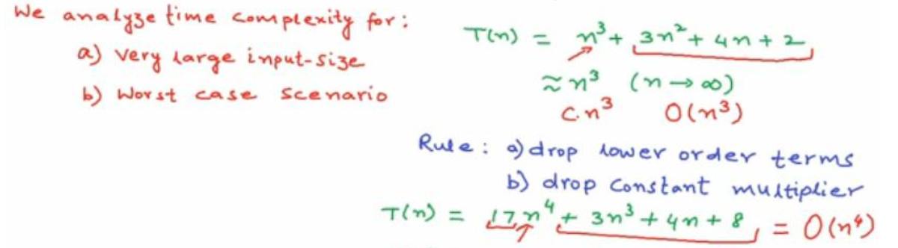
Some general rules again

Slide 26
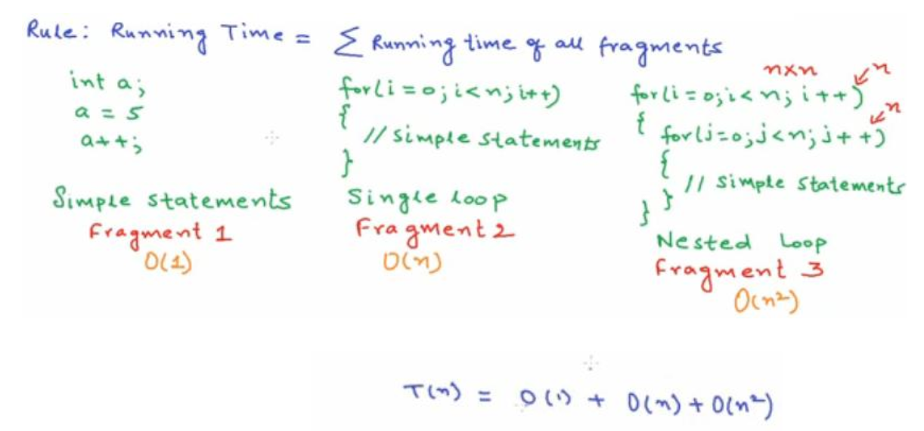
Some general rules again

Slide 27
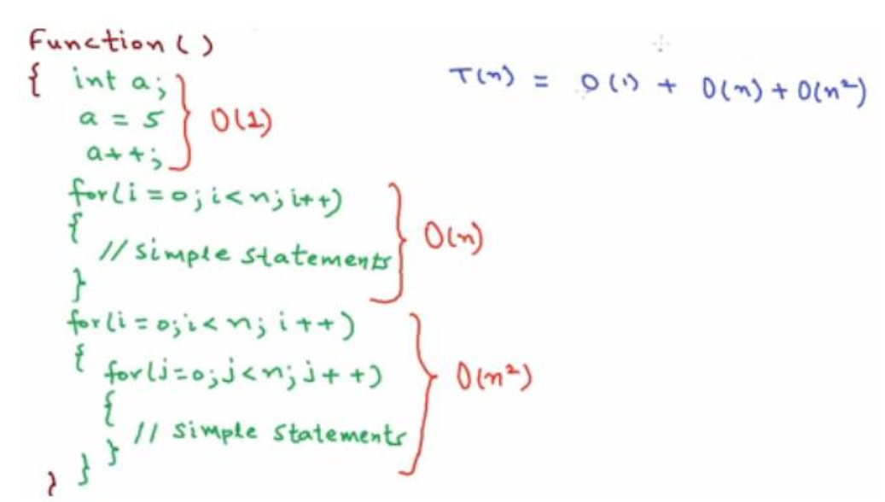
Some general rules again

Slide 28
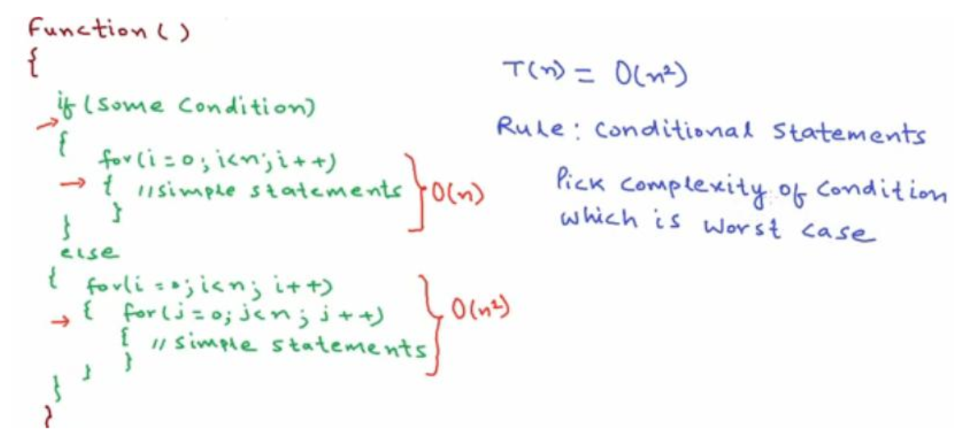
Some general rules again

Slide 29
Common time complexities
O(1) constant time
O(log N) log time
O(N) linear time
O(n log n) log linear time
O(N²) Quadratic time
O(N³) Cubic time
O(2^N) exponential time

Slide 30
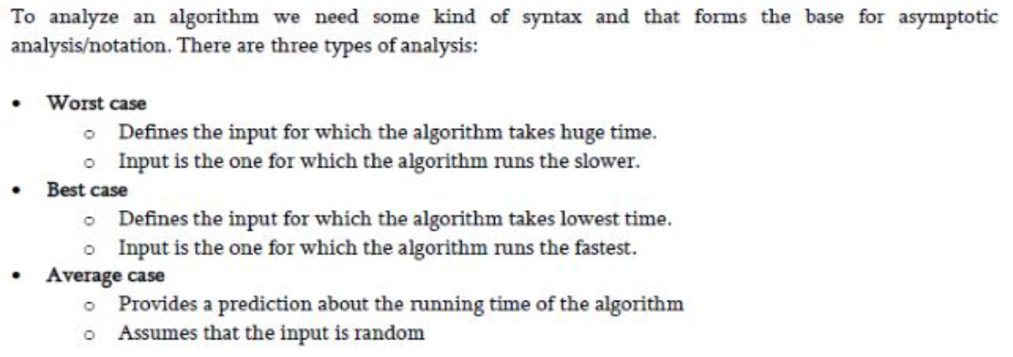
Types of asymptotic analysis

Slide 31
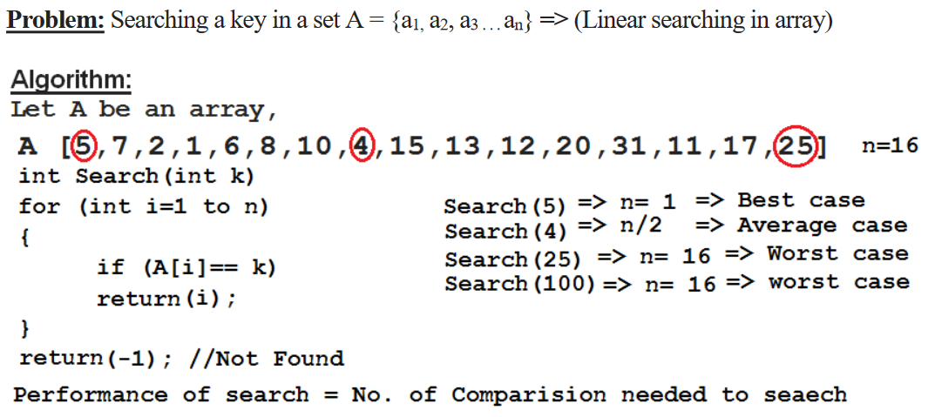
Example of best case, average case, worst case

Slide 32
Conclusion
Best case => Minimum number of comparison => 1 comparison
Worst case => Maximum number of comparison => n comparison
Average case => n/2 comparison
Note: sometimes difficult to find average case.

Slide 33
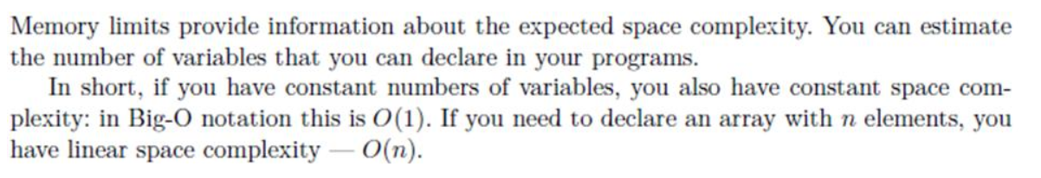
How to analyze a space complexity?

